Slide 1
MENSCH UND COMPUTER 2026 · STUDENT RESEARCH COMPETITION
Monitoring and Understanding
Notebook-Based Learning with Jupyter
A learner-facing JupyterLab dashboard for reflective programming education
Arturo Olivares Martos · Lisa Pawlowski · Mohamed Abdelmagied · Kaimao Sheng · Irene-Angelica Chounta
Universidad de Granada · Universität Duisburg-Essen

Slide 2
MOTIVATION
The programming process is invisible
Computational notebooks are central to modern data science education. Learners repeatedly test, revise, and debug — but that process leaves no trace in a final submission.
1
2
3
Instructors
Learners
Existing dashboards
Lack visibility into how students actually work through a task — only the final notebook is visible.
Rarely get the chance to reflect on their own workflow, error patterns, or problem-solving behavior.
Mostly rely on coarse LMS-level data (grades, access logs) — not fine-grained, cell-level coding behavior.
Research question: Is the dashboard perceived as useful, easy to integrate, and usable — without imposing excessive cognitive workload?
2

Slide 3
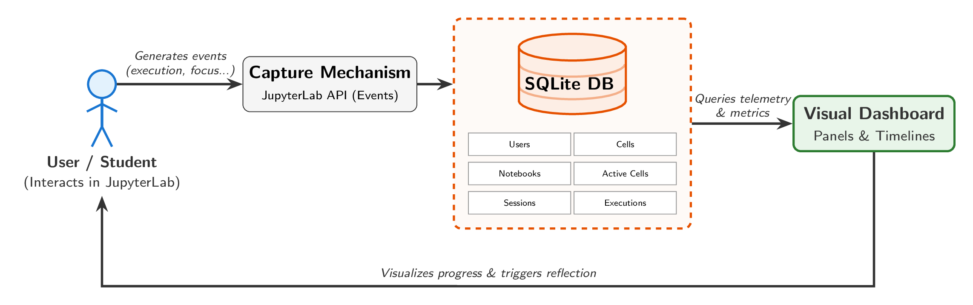
APPROACH
A telemetry pipeline built into JupyterLab
The extension captures notebook interactions live through the JupyterLab API, persists them relationally, and renders reflective visualizations back to the student.
Non-AI, learner-facing reflection interface — embedded directly in the coding environment, not a separate LMS view.
3

Slide 4

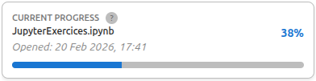
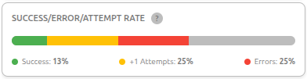
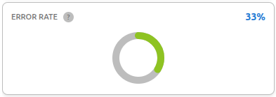
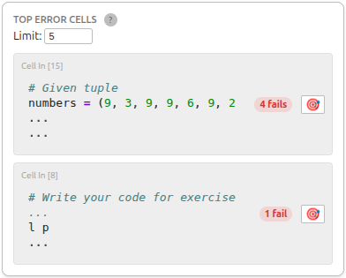
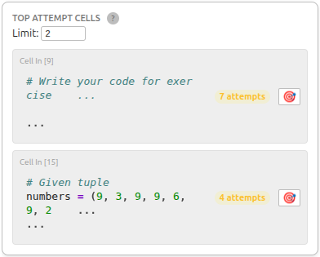
APPROACH
The dashboard, live inside JupyterLab (1/2)
Nine panels, each with its own Help button — accessible from the JupyterLab command palette while students work.
User information
Current progress
Success / Error / Attempt rate
Anonymous ID and role (student / teacher).
% of code cells executed without errors.
Classifies every cell by its final outcome.
Error rate
Top error cells
Top attempt cells
Failed / total executions, color-graded 0–100%.
Cells with the most failed executions.
Cells with the highest number of executions.
5

Slide 5
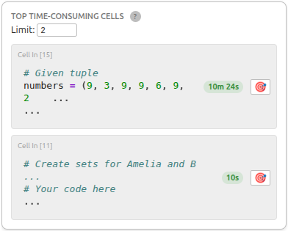
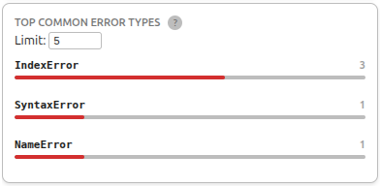
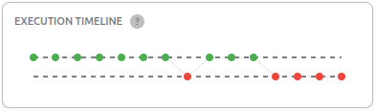
APPROACH
The dashboard, live inside JupyterLab (2/2)
Top time-consuming cells
Top common error types
Execution timeline
Cells ranked by total active focus time during the session.
Tally of specific Python exceptions (IndexError, SyntaxError…).
Chronological, color-coded dot plot of the whole session (green = success, red = error).
Metrics are reflection cues, not diagnostic scores — the Help button explains each one and suggests possible next actions.
6

Slide 6
EVALUATION
An exploratory, learner-centered pilot study
22
students,
varying prior experience
Procedure
1
Informed consent + background questionnaire (Jupyter / Python experience)
~17 min
average time spent using
the dashboard
2
Solve Python exercises in JupyterLab while the dashboard runs live
3
Post-use questionnaires: SUS (usability), TAM (usefulness & ease of use), NASA-TLX (workload)
3
standardized instruments:
SUS, TAM, NASA-TLX
4
Descriptive statistics + exploratory Spearman correlations
Ethics-approved study · Faculty of Computer Science, University of Duisburg-Essen (ID 2601CMPL2910)
6

Slide 7
RESULTS
Usable and low-workload — usefulness more moderate
65.6
5.36
8.15
SUS Score
TAM Overall
NASA-TLX
/ 100 · just below the 68 benchmark
/ 7 · positive technology acceptance
/ 20 · low-to-moderate workload
Perceived Ease of Use vs. Perceived Usefulness
PEOU
5.78
PU
4.93
Students found it easy to operate; its immediate value for self-reflection was less evident — some wanted more actionable, error-specific guidance.
7

Slide 8
CONTRIBUTION
Visibility is only the first step
1
A working system
Implications & next steps
A JupyterLab extension capturing cell-level execution, error, retry, and focus-time data directly — not coarse LMS logs.
Visibility alone isn’t enough — learners need help interpreting patterns and turning them into concrete actions
Strengthen the Help function with more actionable, error-specific guidance
2
Empirical baseline
First learner-centered usability, usefulness, ease-of-use, and workload evidence for a fine-grained notebook dashboard (N = 22).
This was a short-term, cross-sectional pilot (~17 min) — it shows usability, not pedagogical impact
Future work: longitudinal / controlled studies on debugging behavior and learning outcomes over time
8

Slide 9
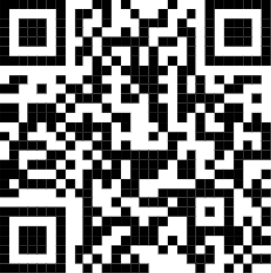
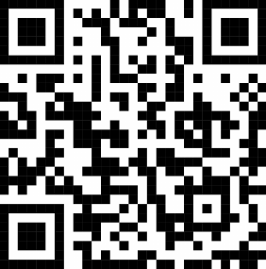
Thank you
Questions & discussion
Video of the Extension
Arturo Olivares Martos arturoolivares@correo.ugr.es
Lisa Pawlowski lisa.pawlowski.99@stud.uni-due.de
Mohamed Abdelmagied mohamed.abdelmagied@stud.uni-due.de
Kaimao Sheng kaimao.sheng@uni-due.de
Irene-Angelica Chounta irene-angelica.chounta@uni-due.de
https://colaps.team/

Slide 10
APPROACH
Reflection cues, not performance grades
Six visualization panels turn raw telemetry into cues students can act on — each with a Help button offering cautious interpretation and next steps.
Progress
Error rate
Success / Attempt / Error rate
% of code cells executed without errors
Failed executions / total executions, color-graded 0–100%
Classifies every cell by outcome
Top error & attempt cells
Top time-consuming cells
Execution timeline
Cells with the most failures or retries, with jump-to-cell links
Cells ranked by total active focus time
Chronological, color-coded dot plot of the whole session
4

